Slide 1



High impact areas for
Population Health
Director of Public Health Report 2025/26
Image courtesy of Dunstable Town Council
Vicky Head
Director of Public Health

Slide 2
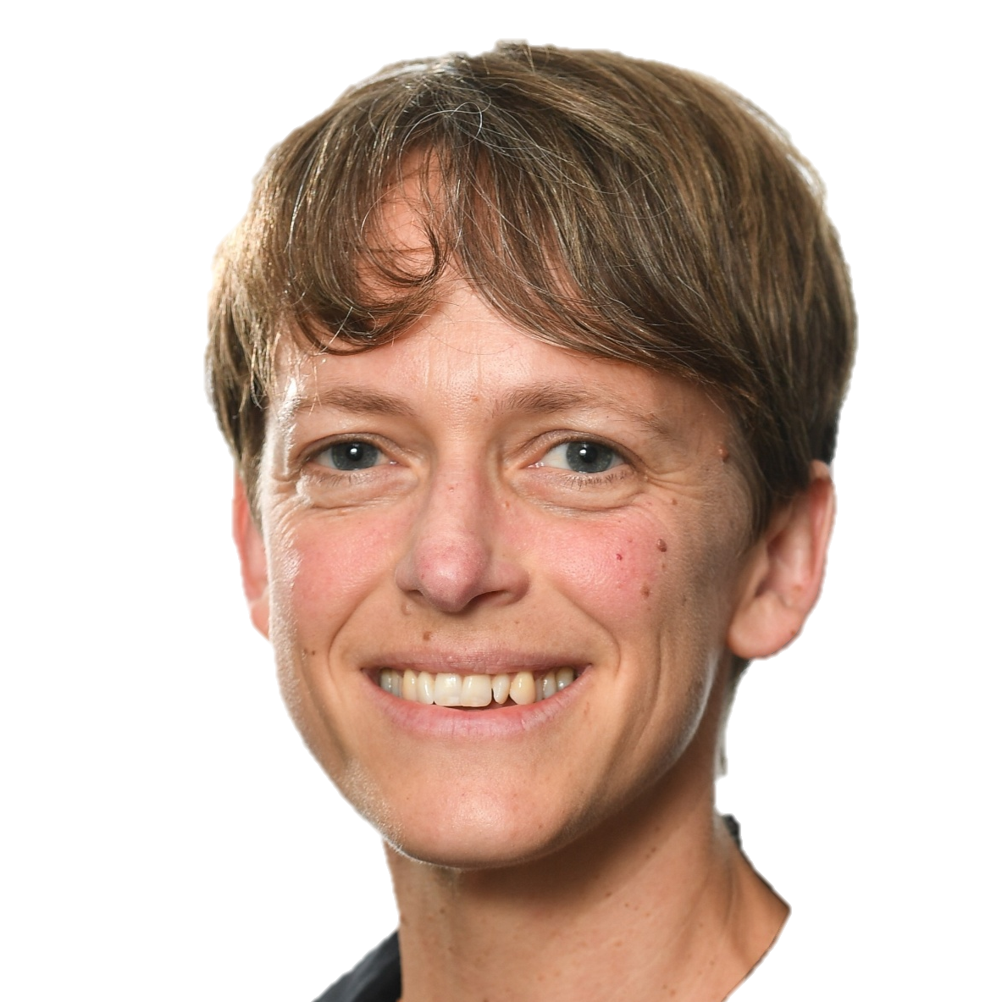
Contents
Introduction from
Vicky Head
Introduction from Vicky Head 2
Introduction and methodology explained 3
Priorities for all ages 5
Making it easier to be active and maintain a healthy weight 6
Working towards a smoke-free environment 7
Promoting good mental health 8
Supporting those who care for others 9
Priorities for children and young people 10
Early and continued access to maternity care 11
Protecting children and young people from infectious diseases 12
Reducing the impact of income deprivation on health and well-being 13
Priorities for people of working age 14
Reducing the impact of poor health as a barrier to work 15
Identify those at risk of long-term health conditions and increase early
access to preventative care 16
Help people change behaviours that impact on their health 17
Priorities for older people 18
Supporting people with dementia to live better for longer 19
Supporting independent living through identification, prevention and
support for age-related conditions 20
Reducing the impact of income deprivation on health 21
Future JSNA developments 22
Spotlight on inequalities and evidence gaps 22
Our health and wellbeing are shaped by many things, but we often talk about health through a medical lens, in terms of physical or mental illness and life expectancy.
Understanding how common diseases affect our communities and the services they depend on is important and I looked at this in my 2024/25 report. However, we also need to understand the personal, social, economic and environmental factors – the building blocks of health – that contribute to our health and wellbeing.
There are hundreds of these factors, and it can be difficult to answer the question ‘what should we work on if we want to have the greatest impact on the health and wellbeing of our local population?’
In my report this year I have chosen to use the findings from the Central Bedfordshire Joint Strategic Needs Assessment (JSNA) to help answer that question.
The purpose of the JSNA is to describe the current and future health, social care and wellbeing needs of the local population. The JSNA is used by the council, the NHS and other local organisations to help service planning, reduce inequalities and improve outcomes for our communities.
The JSNA presents a picture of health and well-being in Central Bedfordshire, using a range of data and insights on the characteristics of the population, the building blocks of health, and patterns of health behaviours and disease. The JSNA is constantly growing, like a library where new books are added as we learn more about our communities.
To identify those areas where we have the greatest opportunity to make a difference, we have reviewed the JSNA and ranked risk factors and health conditions by criteria including the number of people affected locally and the impact on health inequalities.
There are no quick fixes, but we all have a role to play: health and care professionals working with residents; voluntary and community organisations strengthening our communities; the council shaping the environment we live in; and individuals leading healthier lives. Throughout the report I have set out some of the ways we can make a difference.

Slide 3
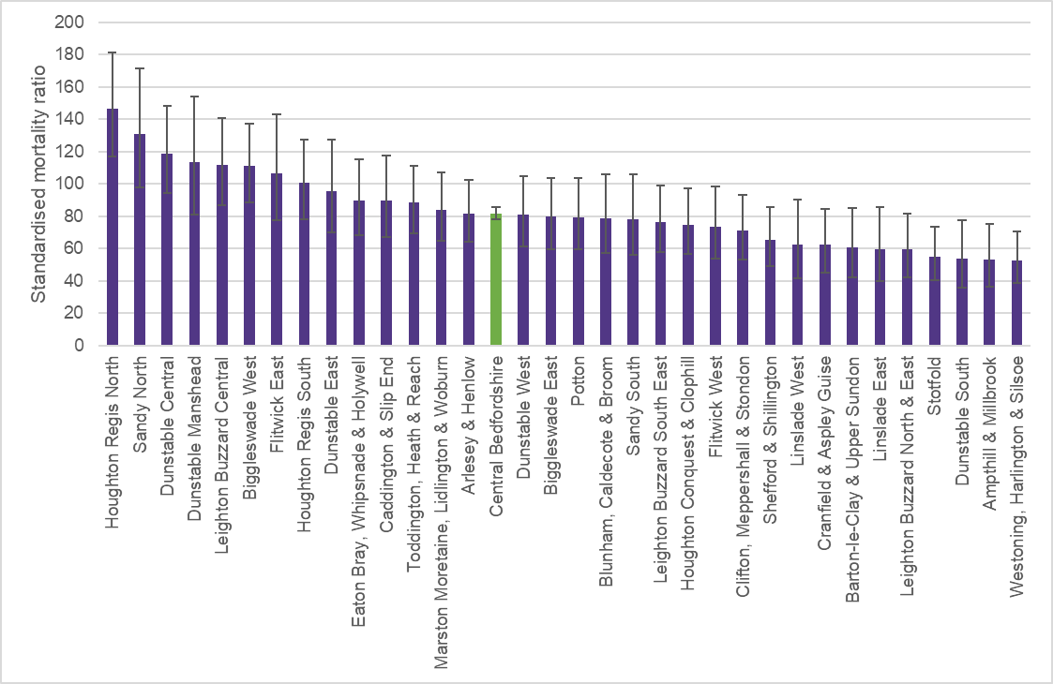
Page 3
Introduction
Central Bedfordshire is a combination of rural communities and fast-growing market towns and has significant opportunities for economic development.
Overall, the health of Central Bedfordshire’s population follows the national trends. Males currently live an average of 80.4 years and live 16.2 of those years in poor health. Females live longer – 84.1 years – but spend 19.4 of those years in poor health.
The numbers are similar to England, but they hide significant differences across
Central Bedfordshire that show that people are not living as long or as well as they should.
Over the period from 2021 to 2023, the latest data available for wards, there were 8.4 years difference in the life expectancy for males between the ward with the highest and lowest and 8.8 years difference for females.
These differences are also reflected in people’s perception of their health. In the 2021 Census, females living in Parkside and Tithe Farm wards were around twice as likely to perceive themselves not in good health than those in Aspley and Woburn. Males were 60% more likely to perceive themselves not in good health
in Parkside ward compared to Aspley and Woburn. (For more see Inequalities in health perception).
Furthermore, there are areas in Central Bedfordshire where the ratio of deaths in people aged 75 years and under that could be prevented by public health and primary prevention interventions are nearly three times higher than others.
Table 1: Life expectancy and healthy life expectancy 2021-23
Figure 1: Mortality from causes considered preventable in people
aged 75 years and under (2019-2023)
Measure | Expected | Gap between highest and lowest wards
Life expectancy at birth male | 80.4 years | 8.4 years
Life expectancy at birth female | 84.1 years | 8.8 years
Healthy life expectancy male | 64.1 years | 8.4 years
Healthy Life expectancy female | 64.7 years | 8.9 years
Source: Demographics Dashboard Central Bedfordshire JSNA https://centralbedfordshire.jsna.uk/jsna/population-place/demographics-dashboard/
Source: Fingertips
Notes:
https://fingertips.phe.org.uk/search/deaths%20considered%20preventable#page/3/gid/1/pat/402/par/E06000055/ati/3/are/E02003620/iid/93480/age/163/sex/4/cat/-1/ctp/-1/yrr/5/cid/4/tbm/1/page-options/car-do-0

Slide 4
Page 4
Methodology explained
We have estimated the potential impact of each issue by considering:
Every part of society has a role to play in improving
health, preventing disease and reducing health inequalities.
Understanding where to put limited resources to have the
greatest impact is not easy – data can help to guide us.
Health and Wellbeing Boards have a responsibility to review the health needs of their local population through the Joint Strategic Needs Assessment (JSNA). The JSNA is comprehensive and detailed, which can make it difficult to summarise. Having an overall sense of the things that have the biggest impact on our health can help different organisations recognise the contribution they can make and to plan and prioritise their efforts.
To do this, we created a tool that estimates the potential impact of different risk factors or health conditions, taking into account:
  The number of people affected;
  How strongly it affects health in Central Bedfordshire, using data from the Global Burden of Disease;
  The extent to which there are health inequalities relating to deprivation and ethnicity;
  The trend over the last five years;
  How the local position compares to the national average.
This report presents the highest impact areas overall and for different age groups.
The opportunity to impact a lot of people
This takes into consideration both the proportion of the relevant population and the total count of people. The proportion of the population is calculated from the number of people in the group affected or from the total population as measured by the ONS mid-year estimates.
The opportunity to reduce years lost to poor health
This relates the indicator to the causes and risk factors of years lost to poor health through premature death, illness or disability as calculated in the 2021 Global Burden of Disease. It takes into account both the number of causes and risks an indicator is linked to, and how closely the indicator is related to those causes and risk factors.
The opportunity to reduce inequalities
This quantifies the relationship between each indicator and ethnicity and deprivation to identify which are most likely to unequally affect our local communities.
The opportunity to reverse a negative trend
This identifies which indicators have got statistically significantly worse over the preceding five years.
The opportunity to close the gap with comparators
This identifies which indicators are statistically significantly worse than the national average.

Slide 5
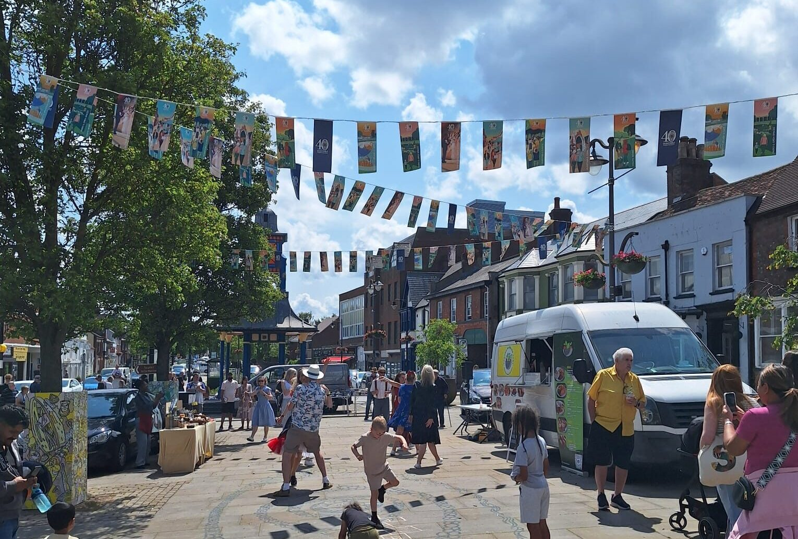
High impact areas:
People of
all ages
Page 5
Our analysis highlights four areas that are common across all age groups:
1
Making it easier to be active and maintain a healthy weight
2
Working towards a smoke-free environment
3
Promoting good mental health
4
Supporting those who care for others
Reduce the proportion of the population that are overweight or obese
Increase the proportion of the population that is physically active
Reduce the prevalence of smoking
Increase the number of people accessing support to stop smoking services
Reduce hospital admissions related to smoking
Reduce the prevalence of common mental health conditions
Reduce the number of people needing emergency hospital admission for mental health conditions
Increase early identification and support
Reduce social isolation
Reduce the inequalities associated with caring responsibilities
Image courtesy of
Dunstable Town Council

Slide 6
Page 6
1
Making it easier to be active and maintain a healthy weight
This has a significant impact on health and wellbeing in Central Bedfordshire because:
Modern life makes it difficult to be physically active, eat well and maintain a healthy weight.
Lots of people are affected
By year 6, 1 in 3 children are overweight or obese. 2 out of 3 adults are overweight or obese, while more than 1 in 4 are not meeting the 5-a-day fruit and vegetable recommendation. Approaching half of children aged 5 to 16 years and around 1 in 6 adults do no meet recommended levels of physical activity and 1 in 7 adults embed physical activity into their daily routine by cycling or walking for travel.
It is a major
cause of poor health
Excess weight is among the top risk factors for years lost to poor health for all age groups. Risks rise as people get older and obesity is linked to heart disease, stroke, type 2 diabetes, musculoskeletal disorders and some cancers, all of which are among the top causes of years lost to poor health. People who are physically active have a 20-35% lower risk of cardiovascular disease, coronary heart disease and stroke compared to those who are sedentary. Physical activity helps prevent major causes of years lived in poor health, including diabetes, osteoporosis, colon and breast cancer, and poor mental health.
What can we do?
Change is needed across the whole of society. Impactful interventions could include:
Designing living, learning and working environments that increase activity;
Using the planning system to limit the impact of unhealthy exposures, such as hot food takeaways;
Increasing the number of people using services to help them lose weight or maintain a healthier weight;
Making it easier for people to access fresh, healthy food at low cost.
It is associated
with inequalities
Children living in more deprived areas are twice as likely to be living with excess weight or obesity than those from less deprived areas. Although this association isn’t as strong for adults, it is still significant and holds true for both levels of physical activity and the proportion of people meeting the 5-a-day fruit and vegetable recommendations.
It is associated
with inequalities
It will affect
more people in
the next 5 years
Over the last ten years, the proportion of children and adults affected by excess weight and obesity has risen steadily. The arrival of GLP-1 medications may moderate this increase for adults. However, financial constraints could worsen health inequalities. Action on the underlying societal causes is needed to prevent obesity in the first place and reduce the need for medications in the future.
Some elements are worse than England
The proportion of adults that embed exercise in their daily routines by walking as a means of travel is around 14%. This is significantly lower than the average for England (19%) and the lowest among other local authorities with similar levels of deprivation. This may reflect the distances many people in Central Bedfordshire have to travel to work and amenities.

Slide 7
Page 7
2
Working towards a smoke-free environment
This has a significant impact on health and wellbeing in Central Bedfordshire because:
Lots of people are affected
Smoking remains the most significant cause of preventable ill health and the leading cause of health inequalities.
Lots of people are affected
Approximately 10% of Central Bedfordshire’s adult population are current smokers, which equates to approaching 25,000 people.
round one in three non-smokers are exposed to second hand smoke. That is equivalent to over 73,000 people.
It is a major
cause of poor health
Smoking is related to four of the top six causes of years lost to poor health for the adult population and is the second highest risk factor. It is a major risk factor for lung cancer and chronic obstructive pulmonary disease, which is a leading cause of poor health among older people. Smoking is also associated with cancer in other organs including the lips, mouth, throat, bladder, kidney, stomach, liver and cervix. Children and young people exposed to smoke have a greater risk of asthma, and babies are at higher risk of sudden infant death.
What can we do?
The UK Tobacco and Vapes Act is creating a generational shift in the acceptability of smoking. For Central Bedfordshire to fully benefit, impactful local interventions could include:
Reducing the availability of illicit tobacco products, for example through the work of Trading Standards teams;
Stopping children and young people from becoming smokers by preventing illegal
sales and continuing to inform and educate;
Making more outdoor spaces smoke-free,
in line with new legislation.
It is associated
with inequalities
The proportion of the population who smoke, and hospital admissions attributable to smoking, rise significantly in areas of higher deprivation.
In the most deprived areas smoking prevalence is nearly 50% higher than in the least deprived nationally, and there are more than double the number of smoking related hospital admissions.
It is not reducing fast enough to reach targets
The proportion of the local adult population that smoke dropped nearly four percentage points from 2022 to 2024, but the decline slowed to just 0.4 percentage points between 2023 and 2024. Such inconsistency suggests reaching the 5% target by 2030 is not certain.
If the 10% figure remained static until 2030, there would be an additional 2,100 adult smokers, based on growth in the population.
If the proportion of the non-smoking population exposed to second hand smoke remained, there would be 7,200 more people exposed in 2030.
It is not reducing fast enough to reach targets
Notes:
Cot death reference – Cancer UK https://www.cancerresearchuk.org/about-cancer/causes-of-cancer/smoking-and-cancer/what-is-passive-smoking
Second hand smoke exposure reference - https://tobaccoatlas.org/challenges/secondhand-smoke/ Original source: GBD 2019.
Smoking prevalence indicator Smoking Prevalence in adults (aged 18 and over) - current smokers (APS) ID 92443

Slide 8
Page 8
3
This has a significant impact on health and wellbeing in Central Bedfordshire because:
Promoting good mental health
Lots of people are affected
1 in 4 adults in the UK experience a mental health problem in any given year. More than 29,000 adults registered with a Central Bedfordshire GP had an unresolved record of depression, while 1 in 4 local people recorded a high anxiety score. There are around 330 emergency admissions for intentional self-harm each year. 5% of all pupils and over a quarter of children identified with SEND required social, emotional and mental health support. More than 2 in every 3 social care users aged 65 years and over do not have as much social contact as they would like.
Good mental health helps us to maintain strong relationships, cope with life’s challenges, and achieve our potential, but over time more people are reporting poor mental health.
It is a major
cause of poor health
Mental health is the number one cause of years lost to poor health for children and number two for adults of working age. The excess mortality rate for people aged 75 years and under was 3 times higher for those with severe mental illness.
Poor mental health has a knock-on effect on other risk factors for poor health. For example, people with a long-standing mental health problem are twice as likely to smoke, and those with severe mental illness are nearly four times more likely.
What can we do?
Impactful interventions could include:
Equipping young people with the social and emotional skills to manage their lives, develop a sense of purpose, maintain good relationships, and cope with life’s challenges;
Creating healthy, safe, caring and inclusive places and communities;
Preventing suicide and alleviating mental distress;
Ensuring people can access timely, appropriate and effective mental health care when they need it.
It is associated
with inequalities
There is a strong relationship between people affected by deprivation and those with depression. There is strong negative relationship with people from ethnic minority groups, meaning that people from ethnic minority groups are less likely to have a record of depression. There is also a moderate relationship between deprivation and excess mortality in adults with severe mental illness (SMI), meaning there are more excess deaths among people with SMI from more deprived areas.
It will affect more people in the next
5 years
There is no trend information available for the common mental health indicators at a local level, but the numbers have been increasing for England overall and are expected to continue to rise. Locally, the number of children requiring SEND provision for social emotional and mental health needs is increasing significantly.
If the current rate of growth continues, there would be around 3,800 pupils in Central Bedfordshire’s schools needing support by the 2029/30 academic year.
Notes:
Cot death reference – Cancer UK https://www.cancerresearchuk.org/about-cancer/causes-of-cancer/smoking-and-cancer/what-is-passive-smoking
Secondhand smoke exposure reference - https://tobaccoatlas.org/challenges/secondhand-smoke/ Original source: GBD 2019.

Slide 9
Page 9
4
This has a significant impact on health and wellbeing in Central Bedfordshire because:
Supporting those who care for others
Lots of people are affected
About 65% of the adult population of the UK will become an informal carer at some point in their lives, meaning that everyone will know someone who is a carer if they are not one themselves. In Central Bedfordshire, there are around 43,000 people caring for others. Of these 4% are young carers aged 5 to 18 years and 25% aged 65 years and over. The majority, 60% of carers, were women and more than 60% were over the age of 50.
Caring for family and friends is part of everyday life for many people in our community and carers need help to remain healthy themselves.
It is a major
cause of poor health
70% of carers known to GPs have a long term physical or mental health condition, disability or illness themselves. Carers are 1.8 times more likely to suffer chronic pain and musculoskeletal disorders - the second greatest cause of years lost to poor health for working aged females, the third greatest for males, and among the top five causes for older people. Carers are 2.3 times more likely to be lonely or socially isolated and half as likely to have a good quality of life.
What can we do?
Ways to support carers could include:
Encouraging people to recognise that they are providing care and to seek support early to protect their own health;
Addressing inequalities in the access to and take-up of services for carers;
Supporting carers to prioritise their own health to be better able to care for others;
Linking data systems together to make it quicker and easier to access support;
Recognising that support for carers goes beyond the caring responsibility to include other family, social groups and work.
It is associated
with inequalities
The proportion of people from ethnic minority communities who identify themselves as carers is lower than the average in Central Bedfordshire, and the proportion receiving service or financial support is even lower. Over 60% of unpaid carers worry about the cost of living and over a quarter have cut back on essentials such as food and heating. Over 1,200 local carers lived in households classified as deprived in at least three of the dimensions measured through the 2021 Census.
It is increasing over time
The number of carers is increasing across all age groups. Increases in the proportion of young carers are driven by more siblings with long term conditions, particularly autism, and an increasing number living in multi-generational homes. Increases in the numbers of adult carers is primarily driven by population change and people living longer with chronic and
life-limiting conditions.
Even if the proportions of the population providing care stayed the same, an additional 2,000 people could be expected to be carers by 2030.
Notes:
Carers poor health references from carers JSNA

Slide 10

High impact areas:
Children & young people
Page 10
The overall health and wellbeing of children and young people in Central Bedfordshire is not significantly different from the rest of the country. However, in the UK, there are many more children and young people suffering from poor health than there should be. Recent national policy changes including the Children’s Wellbeing and Schools Act, SEND reforms and overhaul of children’s social care are all aimed at targeting services where the need is greatest and reducing inequalities.
At a local level, there are wide inequalities in the health and wellbeing of our children and young people that can be reduced.
The high impact areas for children and young people are:
00
2
1
Early & continued access to maternity care
Protecting children and young people from infectious diseases
3
Reducing the impact of income deprivation on health and well-being
Minimise risk of low birth- weight babies
Improve the proportion of mothers breastfeeding
Improve nutrition for mother and baby
Minimise infections in infants
Increase population vaccine coverage of routine childhood and seasonal vaccinations
Reduce the impact of deprivation on:
Children achieving the expected level of development at the end of Reception
Young people’s Attainment 8 score
Oral health
Asthma
iStock.com/Highwaystarz-Photography

Slide 11
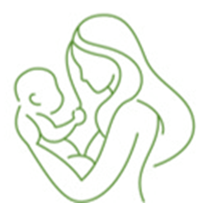
Page 11
1
Early & continued access to maternity care
This has a significant impact on health and wellbeing in Central Bedfordshire because:
Lots of people are affected
Early maternity care relates to 100% of babies and their mothers – around 3,400 births every year. Currently, around one quarter of mothers did not have an appointment booked within 10 weeks of pregnancy as recommended by the National Institute for Health and Care Excellence (NICE) in 2023/24.
Maternity care provides families with the care, treatment and advice that enables healthy pregnancy and supports those with more complex needs.
It is a major
cause of poor health
Timely maternity care helps identify and prevent the top three causes of years lost to poor health for children under the age of five. Mothers who receive early and continued care are 24% less likely to experience a pre-term birth, the primary cause of low-birth-weight babies. Trust in midwives encourages breastfeeding, which helps to prevent malnutrition, which is the greatest risk factor for years lost to poor health in children aged under five.
What can we do?
We need to increase understanding of the importance of early antenatal care and make it easier to access it. This could include:
Using data to identify barriers to booking maternity care and understand the characteristics of women most likely to book care late;
Strengthening awareness of self-referral routes, making sure information is properly accessible;
Increasing promotion of early antenatal care through professionals and trusted community settings.
It is associated
with inequalities
Around one in six babies in Central Bedfordshire are born to women from ethnic minority groups. Across England, rates of early access to maternity care are significantly lower for ethnic minority mothers. Among women from Black ethnic groups, less than half benefit from early access to maternity care. However, nationally they are nearly three times more likely to die during pregnancy and birth, while still births are twice as likely and neonatal deaths are one and a half times more likely.
It is not improving significantly
The proportion of mothers booking an antenatal appointment within 10 weeks of pregnancy has varied around the 70% mark, with a high of 77% and low of 69%. While this is significantly higher than the national average, it remains short of the 100% target.
Parts are worse than England
The rate of early access to maternity care is significantly better in Central Bedfordshire than the national average. However, admissions to hospital for children aged 0 to 4 years for infections is significantly higher. The rate of emergency admissions for lower respiratory tract infections was 294 per 10,000, compared to 212 per 10,000 for England, and the rate for gastroenteritis was 95 per 10,000, compared to 68 per 10,000 nationally.
Notes:
Black mothers mortality data – MBRRACE-UK , Maternal mortality 20212-24 https://www.npeu.ox.ac.uk/mbrrace-uk/data-brief/maternal-mortality-2022-2024
Black babies data – MMBRACE-UK perinatal mortality surveillance – UK perinatal deaths of babies born in 2023 https://timms.le.ac.uk/mbrrace-uk-perinatal-mortality/surveillance/

Slide 12
Page 12
2
Protecting children and young people from infectious diseases
This has a significant impact on health and wellbeing in Central Bedfordshire because:
Lots of people are affected
Vaccines are relevant to all children and young people. If people stop having vaccines, it is possible for infectious diseases to spread quickly. For example, if 95% of children have the MMR vaccine, measles would be stopped from spreading completely but if that rate drops below 90%, measles, mumps and rubella can quickly spread again.
Vaccines are the most effective way to protect children against infectious diseases. Engagement from the whole community will help to ensure everyone is protected.
It is a major
threat to good health
The World Health Organization has listed falling vaccine uptake as one of the biggest threats to global health. Therefore, although infectious diseases have not been one of the top causes of years lost to poor health for children in the recent past, declines in vaccine take up have led to outbreaks, particularly of measles. From a COVID-19 affected low of just 2 confirmed cases in England and Wales in 2021, the number rose to approximately 2,900 in 2024 but fell to 960 in 2025. The average in the 10 previous years was around 560 identified cases per year.
What can we do?
Evidence tells us that the most important thing is to make vaccines as accessible as possible to families, for example by:
Using a range of local venues at convenient times;
Making information about vaccines easy to understand in a range of formats and languages;
Ensuring that professionals working with families take every opportunity to check vaccination status, promote vaccines and
signpost accordingly.
It is associated
with inequalities
Smaller proportions of Central Bedfordshire’s ethnic minority children and young people are likely to be immunised, as nationally there is a strong negative relationship between take-up and ethnicity, meaning that fewer children from ethnic minority groups receive vaccines.
There is potential to improve take up of immunisation through targeting. For example, 86% of children and young people in care are up to date with their vaccinations, lower than the rate for children in care in England.
It is declining over time
Over the last five years, the proportion of children receiving two doses of the MMR vaccines in Central Bedfordshire by the age of five has decreased significantly from 92.2% to 87.9%, significantly below the 95% target. The proportion receiving at least one dose also declined significantly, falling to 93.9%.
If the decline in one dose MMR vaccination coverage continues at the same rate as over the last five years, the proportion of children receiving one dose by five years old will fall below the threshold of 90% by 2032.

Slide 13
Page 13
3
Reducing the impact of income deprivation on health and
well-being
This has a significant impact on health and wellbeing in Central Bedfordshire because:
Lots of people are affected
There are around 7,400 children and young people aged under 16 living in low-income households, meaning around 1 in 8 children in Central Bedfordshire live in poverty. If costs associated with housing are factored in, that number rises to 1 in 5.
As the cost-of-living increases, the effects of deprivation on our children and young people is increasing, often leading to poorer education and health outcomes.
It is a major
threat to good health
Beyond obesity and mental health, early development, academic attainment, oral health and asthma are the factors most affected by deprivation in children. Early development and academic attainment are core building blocks of health, while chronic respiratory disease is the fifth highest cause of years lost to poor health for school-aged children and young people. Asthma is the most prevalent condition for children aged 14 years and under with over 1,100 children diagnosed and is a leading cause of hospital admissions. Tooth decay is the leading cause of hospital admissions for five- to nine-year-olds.
What can we do?
Locally, we can reduce the impact of deprivation by, for example:
Ensuring that effective local multi-agency support for families is available through Family Hubs as well as community groups and the voluntary sector;
Helping families access all the financial support that they are entitled to;
Ensuring that every child is offered a 2 to 2½ year check and appropriate support is provided when needed.
It is associated
with inequalities
The gap between the proportion of five-year-olds with visually obvious dental decay for the children from the most and least deprived areas is 22 percentage points, while the rate of hospital admissions due to asthma for people aged under 19 years in the 10% most deprived areas is more than double that for least deprived 10%.
It is increasing over time
Between 2021/22 and 2024/25, the proportion of children aged under 16 years living in poverty in Central Bedfordshire increased slightly, with the proportion in relative low income households rising from 11.2% to 11.7%.
If this rate of change continued, the number of children aged under 16 years living in relative low income households would increase by more than 10% by 2030/31.
Parts are worse than England
The proportion of children with free school meal status achieving a good level of development at the end of reception in Central Bedfordshire is 43%, significantly lower than the national average of 51%.
Notes:
https://www.nuffieldtrust.org.uk/news-item/what-is-the-scale-of-the-challenge-to-address-health-inequalities-affecting-children-and-young-people

Slide 14

High impact areas:
Working-aged people
Page 14
Employment is one of the most significant social determinants of health. Good work provides financial stability, a sense of purpose, social connections, and daily structure, which lowers mortality rates and protects against mental health issues such as depression and anxiety. Being out of work is widely linked to poorer health outcomes, including a higher risk of limiting long-term illnesses and lower life expectancy.
The health of the working-age population impacts directly on economic productivity, workforce supply, and social wellbeing. A healthy workforce supports economic growth, while poor working-age health strains resources and widens inequalities.
The high impact areas for working-aged people are:
1
Reducing the impact of poor health as a barrier to work
2
Identify those at risk from long-term conditions and increase early access to preventative care
3
Help people change behaviours that impact on their health
Reduce the employment gap between those who are disabled and those who aren’t
Support those in routine and semi-routine occupations who are at higher risk of poor health
Identify those at risk of having long-term conditions and increase early access to preventative care
Reduce the unmet need for drug and alcohol treatment
Reduce the prevalence of smoking and smoking attributable admissions to hospital
Image courtesy of
Dunstable Town Council

Slide 15
Page 15
1
This has a significant impact on health and wellbeing in Central Bedfordshire because:
Reducing the impact of poor health as a barrier to work
Lots of people are affected
80% of people aged 16 to 64 are estimated to be in employment but around 35,000 people are not working, of whom 30,100 are economically inactive (not seeking work), and of these an estimated 1 in 4 are inactive due to long term poor health. 5,400 are unemployed and claiming benefits.
A healthy workforce drives economic growth, while not having work or working in unsatisfactory jobs, can lead to poorer physical and mental health.
It is a major
threat to good health
Unemployed males in Central Bedfordshire are twice as likely as than those in employment to perceive themselves as not in good health and females over one and a half times more likely. Long-term physical or mental health conditions are the top causes of years lost to poor health, and people who have these are 17 percentage points less likely to be in work than the general population. People in routine and manual jobs are 80% more likely to smoke – the number two risk factor for years lost to poor health in Central Bedfordshire.
What can we do?
Actions to tackle worklessness and poor health as a barrier to work could include:
Employers creating healthier and more inclusive workplaces;
Helping people who are in work to stay healthy by improving access to behaviour change support and preventative healthcare;
Linking people who experience barriers to work with effective support;
Encouraging job creation through skills development and strategic partnerships with local businesses and education providers.
It is associated
with inequalities
People working in elementary jobs, such as cleaners, delivery drivers, construction labourers, and farm workers; those working in caring, leisure and other service occupations; and those working in sales and customer service, , as well as male process, plant and machine operatives, are all less likely to be in good health than the average for Central Bedfordshire. There is also a moderate relationship between unemployment and ethnicity, suggesting people in our local ethnic minority communities are more likely to be unemployed.
Employment gaps are increasing
over time
The gap in the rate of employment between people with a long-term physical or mental condition and the overall employment has increased notably since the COVID-19 pandemic, although the rate is not significantly different from the England average.
If the 2024/25 rates remain constant, an estimated 33,850 people aged 16 to 64 will be economically inactive and 4,950 unemployed and claiming benefits by 2029/30.
Parts are worse than England
Notes:
Source for long term health condition as a reason for economic inactivity, OHID Dashboard https://app.powerbi.com/view?r=eyJrIjoiYjJjZjNlMzYtZDBiNS00MGQ3LWI5ZGItZDRhMjY1ZjQzNDVjIiwidCI6ImVlNGUxNDk5LTRhMzUtNGIyZS1hZDQ3LTVmM2NmOWRlODY2NiIsImMiOjh9

Slide 16
Page 16
2
Identify those at risk of long-term health conditions and increase early access to preventative care
This has a significant impact on health and wellbeing in Central Bedfordshire because:
Lots of people are affected
Among the working aged population, long term conditions are common: 37,700 had anxiety; 28,100 depression; 17,500 hypertension; 12,100 asthma; 10,400 musculoskeletal conditions, 5,600 cardiovascular disease, 7,900 diabetes, and 4,600 cancer. These numbers cannot be added together as many people will have more than one condition, but at least
1 in 5 working aged people are affected by a physical or mental condition.
Working age is when the prevalence of long-term illnesses increases. Prevention and early identification are fundamental to ensuring better outcomes.
It is a major
threat to good health
The most prevalent conditions also impact most on years lost to poor health e.g. musculoskeletal disorders, mental disorders, cancers, cardiovascular diseases, respiratory diseases and diabetes. Screening and testing programmes relate directly to cancers and cardiovascular disease, two of the top six causes of years lost to poor health. NHS Health Checks seek to identify and address major risk factors. However, of the people referred for additional help with weight management or stopping smoking, over 90% declined support.
What can we do?
Early identification and good management of
long-term conditions is important to prevent them getting worse. We could make a difference by:
Increasing uptake of NHS Health Checks and screening programmes, especially among higher risk groups;
Being more proactive in the healthcare offered to people with long-term conditions, making sure the care they receive is optimal;
Supporting people with long-term conditions to live healthy lives, for example by being active, maintaining a healthy weight, socialising, and stopping smoking.
It is associated
with inequalities
There is a very strong relationship between deprivation and deaths that are considered preventable, meaning that people from areas of deprivation are more likely to die
unnecessarily. Nationally, people from ethnic minority groups are less likely
to have screening for cervical, bowel and breast cancer, though, in contrast, they are more likely to receive an NHS Health Check.
It is getting worse over time
The proportions of the local population with diabetes, hypertension or asthma are increasing, while the proportion of younger females being screened for cervical cancer is decreasing.
If the prevalence of diabetes continues to change at the same rate as for the previous five years, it will rise from 7.9% in 2024/25 to 9.8% in 2029/30. If the rate of decline in cervical cancer screening continues, the proportion of females aged 25 to 49 being screened would
fall from 73.9% in 2024 to 71.1% in 2030.
Parts are worse than England
The prevalence of asthma in the population aged 6 and over is significantly higher in Central Bedfordshire than England. The mortality rate for deaths involving hypertensive diseases is significantly higher than England. In addition, the proportion of people being invited to and receiving NHS Health Checks is significantly lower than the England average.

Slide 17
Page 17
Page X
3
This has a significant impact on health and wellbeing in Central Bedfordshire because:
Help people change behaviours that impact on their health
Lots of people are affected
Of Central adult population, an estimated 10% are current smokers. It is also estimated that approximately 1 in 5 adults drink alcohol regularly at levels that increase their risk of ill health. 0.85% are opiate and/or crack cocaine users.
These proportions equate to approaching 25,000 adults smoking and 50,000 drinking alcohol at levels that increase their risk of ill health. There are also around 2,100 opiate and/or crack cocaine users.
As we age, the cumulative impact of unhealthy behaviours begins to affect our bodies – stiffening arteries, increasing insulin resistance, and damaging organs such as the lungs and liver. In turn this increases the risk of long-term conditions.
It is a major
threat to health
Smoking is related to three of the top six causes of years lost to poor health for Central Bedfordshire’s adult population and is the second highest risk factor. Alcohol and drug misuse relate to the seventh highest cause of years lost to poor health and is the top risk factor for males.
What can we do?
Most people know what makes them healthy, but that doesn't necessarily mean they are able to make healthy choices. Changes to our environment to make healthy behaviours easier can have the most impact, but we could also make a difference by:
Increasing access to and uptake of support to stop smoking and maintain a healthy weight;
Frontline professionals having more conversations with residents about health behaviours and signpost to support services;
Preventing alcohol-related harms and increase numbers of people engaging with local support.
Smoking prevalence, hospital admissions attributable to smoking, and the proportion of dependent drinkers all have a very strong relationship with deprivation, meaning the proportions of people affected is significantly higher in areas of higher deprivation.
Admissions for alcohol-specific conditions has a moderate relationship with deprivation.
It is associated
with inequalities
It is increasing over time
The rate of smoking attributable hospital admissions increased significantly in Central Bedfordshire in the five years to 2019/20 from a low of 1,038 per 100,000 admissions, to 1,330.
If this increase continues at the same rate, by 2029/30, the rate of smoking-attributable admissions would reach 1,392 per 100,000.
Parts are worse than England
The proportion of the local population who successfully quit smoking in Central Bedfordshire is significantly below that for England overall and has been for three of the last four years.
For females, the potential working years of life lost due to alcohol-related conditions, was significantly higher than England in 2024 having increased significantly over the previous five years.
Notes:
Source for alcohol consumption - https://www.gov.uk/government/publications/delivering-better-oral-health-an-evidence-based-toolkit-for-prevention/chapter-12-alcohol#alcohol-consumption
It cites 21% of adults in England. Based on the religious make-up Bedford compared to England, Bedford is likely to be lower but not hugely so - I estimate 19.3%, therefore approaching 1/5 would seem a reasonable number. For CBC approximately 1 in 5 is fine based on ethnic mix similar to region.

Slide 18
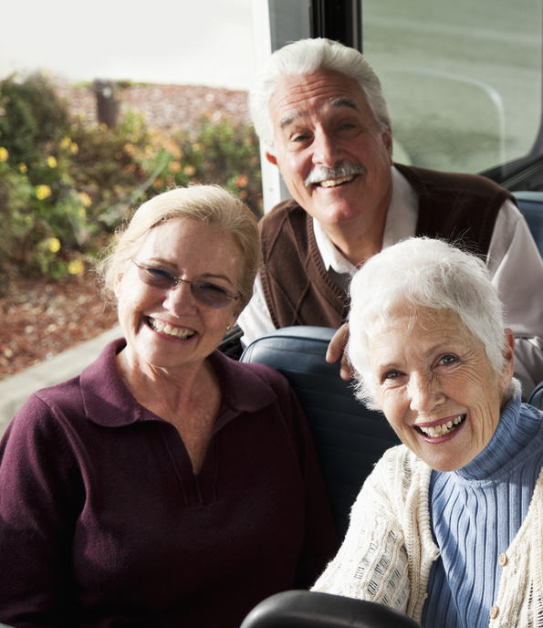
High impact areas:
Older
people
Page 18
People aged 65 years and over are the fastest growing age group in Central Bedfordshire, and the group with the greatest number of people in poor health. Helping people stay healthy and independent for as long as possible is important for the wellbeing of our population, and the ability of health and social services to keep up with demand. (See the 2024 Director of Public Health Report for more on how the demand for healthcare may rise). At a local level, there are significant inequalities in the health and wellbeing of our older population.
The high impact areas for older people are:
1
Supporting people with dementia to live better for longer
2
Supporting independent living through identification, prevention and support for age-related conditions
3
Reducing the impact of income deprivation on health
Increase the proportion of people with dementia who are diagnosed at an early stage
Increase awareness of pathways to support for people with dementia
Early identification of sight loss
Prevention and rehabilitation for falls and fractures
Improve the quality of living conditions including the suitability of available housing
Increase the availability and affordability of heating
iStock.com/kali9

Slide 19
Page 19
1
Supporting people with dementia to live better for longer
This has a significant impact on health and wellbeing in Central Bedfordshire because:
Lots of people are affected
There are approximately 2,300 people registered as living with dementia in Central Bedfordshire
However, it is estimated that over 3 in 10 people with dementia are undiagnosed, meaning there may be almost 3,000 people living with dementia in Central Bedfordshire, of whom approaching 700 are not accessing the support and care that is available because their condition has not been formally recognised.
Dementia is devastating, but addressing underlying causes earlier in life can help reduce the risk. Timely diagnosis means people get the care they need which, in some cases, can slow progression of the disease.
It is a major
threat to health
Dementia is one of the top four causes of years lost to poor health for people aged 65
and over in Central Bedfordshire. It accounts for about 12% of deaths in England and Wales of people aged 65 and over and is the leading cause of death for people in England and Wales aged 80 years and over.
Quality of life is heavily impacted by dementia. Maintaining people’s independence as long as possible and minimising distress associated with health treatments, particularly hospital admission, is a priority. There were around 1,800 emergency admissions to hospital for people with dementia, and emergency admissions accounted for a higher proportion of healthcare activities for dementia patients than the average for all conditions.
What can we do?
Around 45% of dementia cases are preventable. Adopting healthier behaviours in adulthood reduces the risk of developing dementia. For people who have developed dementia, their quality of life can be improved through, for example:
Timely diagnosis and access to care;
Community support for people with a diagnosis and their families and carers;
Support to maintain independence, particularly to prevent physical frailty.
It is increasing over time
The estimated diagnosis rate for people aged 65 and older was 65.8 % in Central Bedfordshire. This has been increasing steadily since 2021 and has been in line with the England average since 2024.
There is evidence that the rate of dementia is declining as underlying causes in earlier life are addressed. However, as the number of older people is increasing faster, the number of people being diagnosed with dementia is increasing.
The number of people living with dementia in Central Bedfordshire is estimated to increase by 54% to 86% between 2023 to 2043, depending on the model used. This is equivalent to approximately 2,000 additional people living with dementia by 2043.

Slide 20
Page 20
2
Supporting independent living through identification, prevention and support for age-related conditions
This has a significant impact on health and wellbeing in Central Bedfordshire because:
Lots of people are affected
Falls are the largest cause of emergency hospital admissions for older people. In 2024/25, there were over 1,000 falls involving older people and 300 hip fractures in Central Bedfordshire that resulted in hospital admissions.
As people age, maintaining their independence becomes both more difficult and more important. Supporting independence in the face of physical challenges is essential to healthy ageing.
It is a major
threat to health
Musculoskeletal disorders including osteoporosis, unintentional injuries and sense organ diseases are all in the top 10 causes of years lost to poor health, while falls are a major predictor of people moving from their own home to long-term nursing or residential care.
Hip fractures are debilitating and associated with higher levels of mortality. On average,
1 in 3 people with a hip fracture leave their own home to move into long-term care.
What can we do?
We can promote healthy ageing by, for example:
Making collective efforts to support people to remain as independent as possible, for as long as possible;
Preventing falls and fractures by promoting strength and balance training, assessing and adapting homes, and identifying and treating osteoporosis;
Identifying and correcting sight loss early, particularly in diverse communities.
It is associated
with inequalities
It is expected that hip fractures are less likely to be suffered by Central Bedfordshire’s
ethnic minority groups, as there is a negative relationship between ethnicity and hip
fractures nationally.
Conversely, there is a moderate positive relationship between ethnicity and registered blindness in people aged 65-74 years. The relationship weakens in people aged 75 years and over, suggesting that early sight loss is potentially more common in ethnic minority communities.
It is increasing over time
The prevalence of osteoporosis increased significantly from 0.5% to 0.7% in the five years to 2024/25. The percentages of people aged 65 and over offered reablement services following discharge from hospital, and of those still at home 91 days after discharge, both declined significantly in the five years up to 2021/22.
If the trends continued, by 2030: the prevalence of osteoporosis would increase to 0.9%; the percentage of people offered reablement after hospital discharge would decline to under 2%; the percentage of people still at home after discharge from hospital into reablement would fall below 65%.

Slide 21
Page 21
3
Reducing the impact of income deprivation on health
This has a significant impact on health and wellbeing in Central Bedfordshire because:
Lots of people are affected
It is estimated that 7.2% of Central Bedfordshire’s population aged 60 years and older experienced income deprivation, which would equate to over 4,000 people aged 65 and over living in poverty in 2025.
The 2021 Census also identified 925 Central Bedfordshire residents aged 65 years and over living in households deprived in the housing dimension, meaning their accommodation was overcrowded, part of a shared dwelling, or had no central heating.
Deprivation has a profound impact on older people, often affecting their housing, heating and nutrition, as well as increasing their risk of physical illness and injury.
It is a major
threat to health
There are strong relationships between deprivation and the prevalence of
common mental disorders in people aged 65 years and over, the diagnosis rate for
dementia, the prevalence of smoking and obesity, as well as good nutrition – all of which
are major causes or risk factors for years lost to poor health for older people.
In addition, there are specific living conditions that were associated with higher proportions of older people identifying themselves as not being in good health. The gaps are:
22 percentage points (66%) between renters and those who owned their own home;
16 percentage points (47%) between people living in shared accommodation, flats, terraced houses and mobile homes and those living in semi-detached or detached homes;
20 percentage points (58%) between those without additional bedrooms and those with additional bedrooms.
What can we do?
Locally, we can reduce the impact of income deprivation by, for example:
Ensuring that older people access all the financial support that they are entitled to;
Connecting older people to advice and support to help reduce their energy bills
and stay warm in winter;
Providing opportunities for older people to socialise and develop a network of informal local support.
It is increasing over time
The proportion of older people living in deprivation increased from 5.5% in 2019 to 7.2% in 2025. By 2030 there would be:
approximately 4,700 older people living in deprivation if the proportion remained stable at 7.2%;
approximately 5,800 older people living in deprivation if the proportion continued to increase at the same annual rate as from 2019 to 2025.

Slide 22

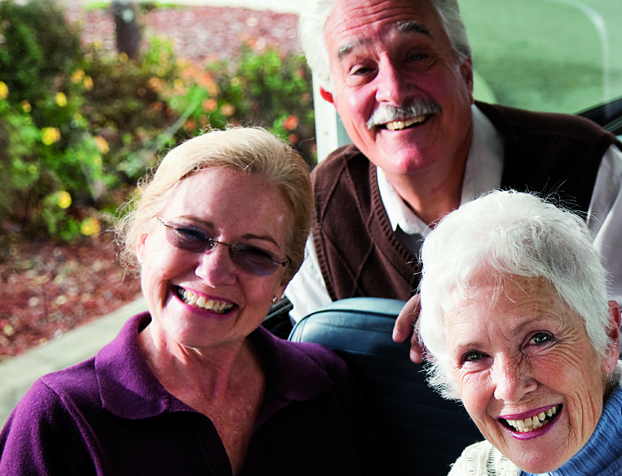
Page 22
Future JSNA developments
The JSNA continues to evolve and there are areas that have emerged from the data that require greater attention.
Local evidence gaps
There are a range of different information sources from international trends to academic research papers to reports from service providers in our local areas, which point to issues that are affecting the health and wellbeing of the people of Central Bedfordshire that have yet to be fully identified and understood. These will be the focus of our JSNA work over the next year.
Putting inequalities under the spotlight
There are many groups of people in Central Bedfordshire that experience different health and wellbeing outcomes from that desired, or from the average. Some of these inequalities, such as those based on deprivation are quite well understood. Others, such as ethnicity are understood at a high level, but what this means for specific ethnic communities within Central Bedfordshire is not always as clear. Furthermore, there could be greater understanding of how different services and interventions reach and are received among different groups. Finally, there are personal characteristics that academic research and our analysis of the general health question in the 2021 Census highlight as reasons for unequal health outcomes. These include:
LGBTQIA+
Neurodiversity
Occupation
It is a priority going forward that we put greater focus on addressing these inequalities at a population level. To do that requires stronger and deeper ties with communities, as well as systematic recording of the characteristics. This relies on teams across healthcare, local authorities and the voluntary, community and social enterprise sector working together.
Physical activity
Loneliness
Vaping
People of
all ages
Children & young people
1
Homelessness
Frailty
Working aged people
Older
people

