Slide 1
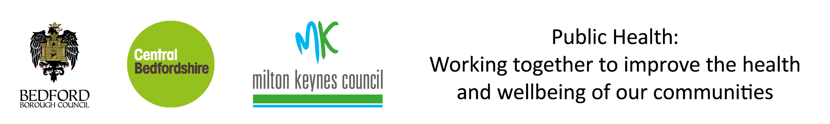
English Index of Multiple Deprivation 2019
Central Bedfordshire Council
The English Index of Multiple Deprivation 2019
Central Bedfordshire Results
Produced by
Population Health, Evidence & Intelligence
October 2019

Slide 2
The English Index of Multiple Deprivation 2019
Central Bedfordshire Results
Introduction
The Index of Multiple Deprivation (IMD) is the official measure of relative deprivation in England and is part of a series of outputs making up the English Indices of Deprivation (IoD). IoD 2019 was published on 26th September 2019 and replaces the 2015 version. This briefing presents the headline IMD findings from the 2019 publication. The English IoD are published by the Ministry of Housing, Communities & Local Government.
The IoD brings together 39 indicators into seven distinct domains of deprivation covering income, employment, education, health, crime, housing and environment. These are grouped further into the Index of Multiple Deprivation. The IMD is an overall measure of multiple deprivation experienced by people living in an area and is calculated for every Lower-layer Super Output Area (LSOA), or neighbourhood, in England. All neighbourhoods in England are ranked according to their level of deprivation relative to other areas. Average IMD measures are available at local authority level.
Key Findings – Central Bedfordshire
Central Bedfordshire ranks 137 out of 151 upper tier and unitary local authorities (where 1 is most deprived) and 254 out of 317 lower tier and unitary local authorities. These rankings have changed from 137 out of 152 and 260 out of 326 respectively in 2015, indicating that CBC has seen no substantive change in relative deprivation since 2015.
3 out of 157 LSOAs in CBC are ranked in the most deprived 20% nationally, with 0 among the most deprived 10%. The most deprived LSOAs are Central Bedfordshire 030C, 025C and 015B, which fall within the wards of Dunstable-Manshead, Parkside and Flitwick respectively. In general, the more deprived areas in Houghton Regis have become slightly less deprived, while 015B in Flitwick has become more deprived.
Compared to the 2015 IMD, the number of LSOAs in the most deprived 20% nationally has fallen from 5 to 3 and the number in the most deprived 10% has remained at zero.
Overall, 77 LSOAs rank as less deprived in 2019 than in 2015, and 80 rank as more deprived. Therefore, while Central Bedfordshire ranks marginally less deprived in 2019, this masks increasing deprivation in some areas.
Further information
The full IoD data along with technical details and national summary reports can be found here:
https://www.gov.uk/government/statistics/english-indices-of-deprivation-2019
A helpful visualisation tool of the national results can be found here:
http://dclgapps.communities.gov.uk/imd/iod_index.html

Slide 3
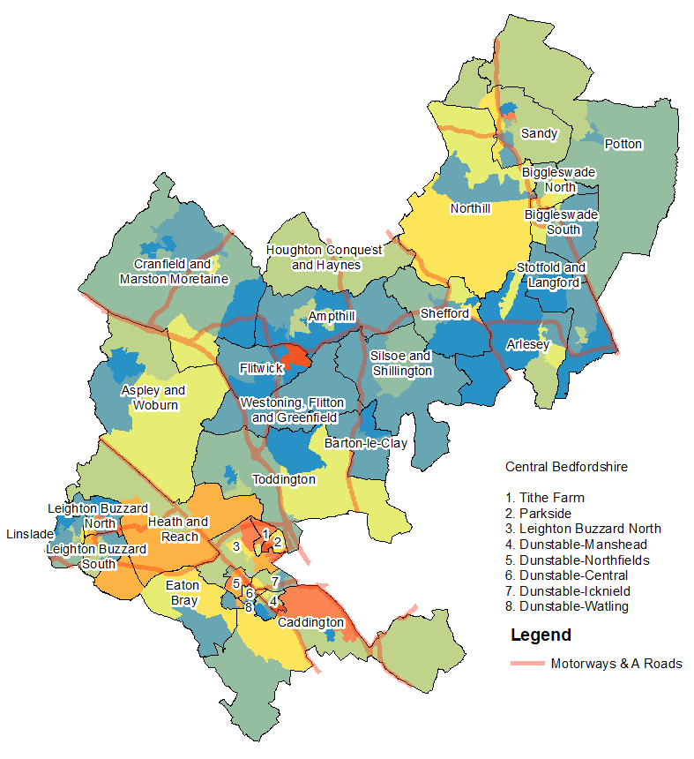
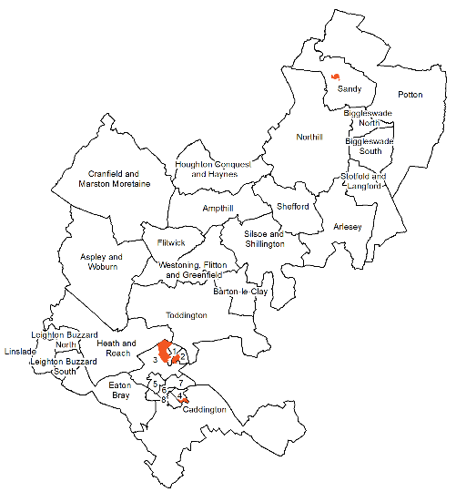
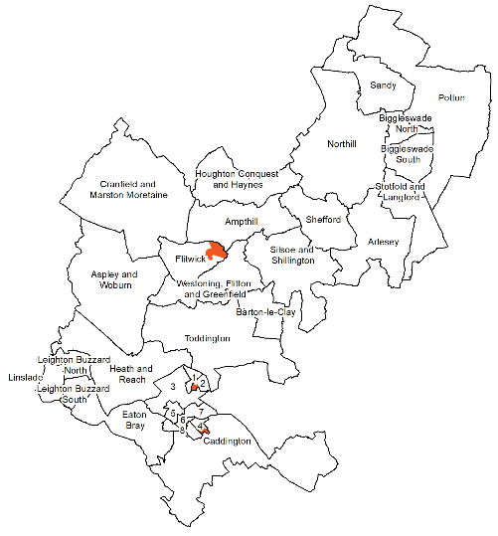
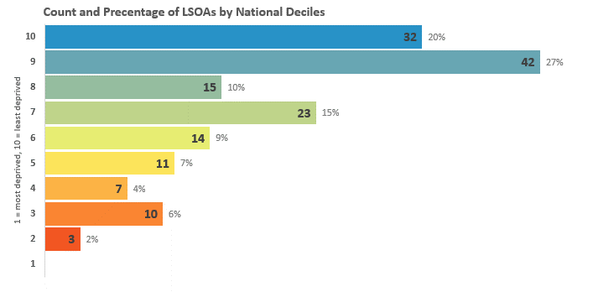
The English Index of Multiple Deprivation 2019
Central Bedfordshire Results
Index of Multiple Deprivation
The overall Index of Multiple Deprivation (IMD) is a weighted measure based on information
relating to income, employment, education, health, crime, housing, and environment.
Map 1: Distribution of the Index of Multiple Deprivation 2019
Change in areas amongst the most deprived 20% in England
2015
2019
Legend
10% most deprived
20% most deprived

